Slide 1
Capstone Project 3 Application of Deep Learning for the Stability Prediction of the Smart Grids
Wei Ruan
Springboard Data Science Student 2022-2023

Slide 2
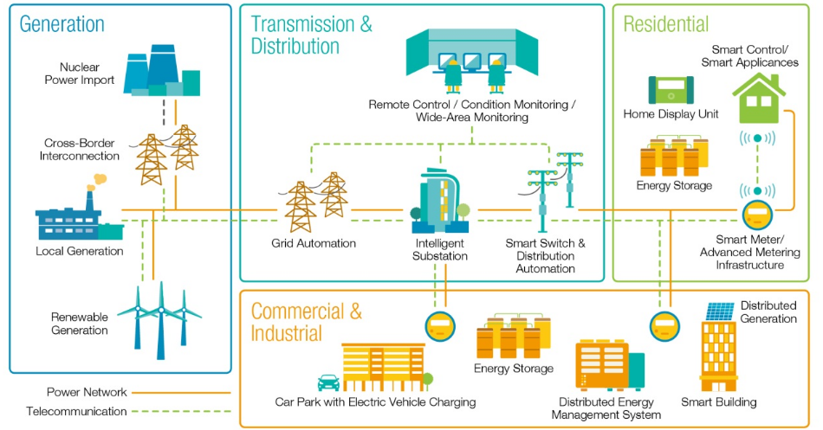
Problem statement
Decentral Smart Grid Control System
Goal of this project – develop a deep learning model for a four-node-star electrical grid with a centralized production with the precision more than 90% to predict the stability of this power grid.
Notes:
The energy consumption in the building sector accounts for approximately 20-40% of the total energy consumption, and heating, ventilation, and air conditioning (HVAC) systems consume approximately 50-60% of the total energy consumed by the buildings.
This project will develop a data-driven AFDD scheme for air handling units (AHUs) with the precision of over 80% to detect common faults of HVAC, which will detect faults early that could be repaired to save energy, improve the reliability and thermal comfort of buildings

Slide 3
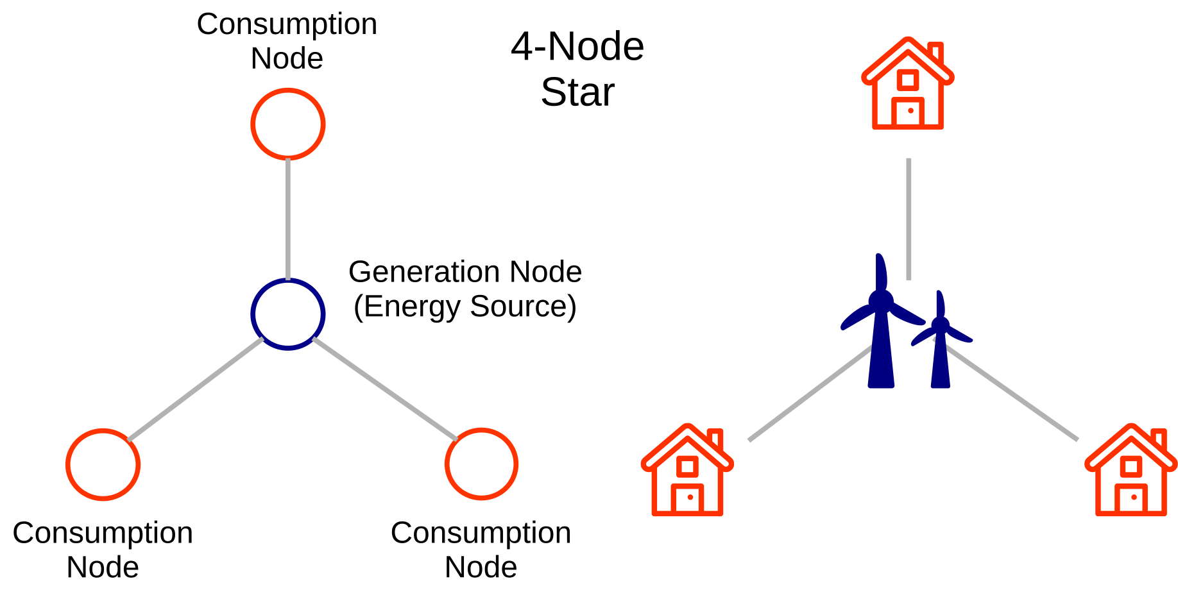
Dataset
Originally provided by KIT
10,000 observations for 14 variables
12 primary features and 2 dependent variables
About 2 months with a ten-minute interval
Augmented data with 60,000 observations

Slide 4

Data Structure
Predictive features:
'tau1' to 'tau4': the reaction time of each network participant;
'p1' to 'p4': nominal power produced (positive) or consumed (negative) by each network participant;
‘g1' to 'g4': price elasticity coefficient for each network participant;
Dependent variables:
‘stab': the maximum real part of the characteristic differentia equation root (if positive, the system is linearly unstable; if negative, linearly stable);
‘stabf': a categorical (binary) label ('stable' or 'unstable').

Slide 5
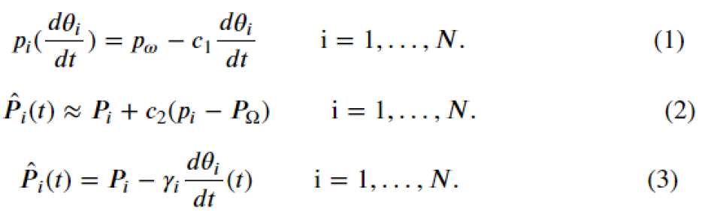
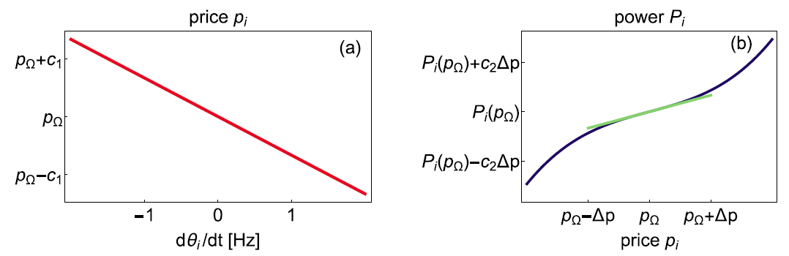
Data Wrangling
Data relationships - tau, p, P
Notes:
where γi is proportional to the price elasticity of each node i, i.e., measures how much a producer or consumer is willing to adapt.
In general, such an adaptation will notbe instantaneous but will be delayed by a certain time τ by a measurement and the following reaction their consumption or production.

Slide 6
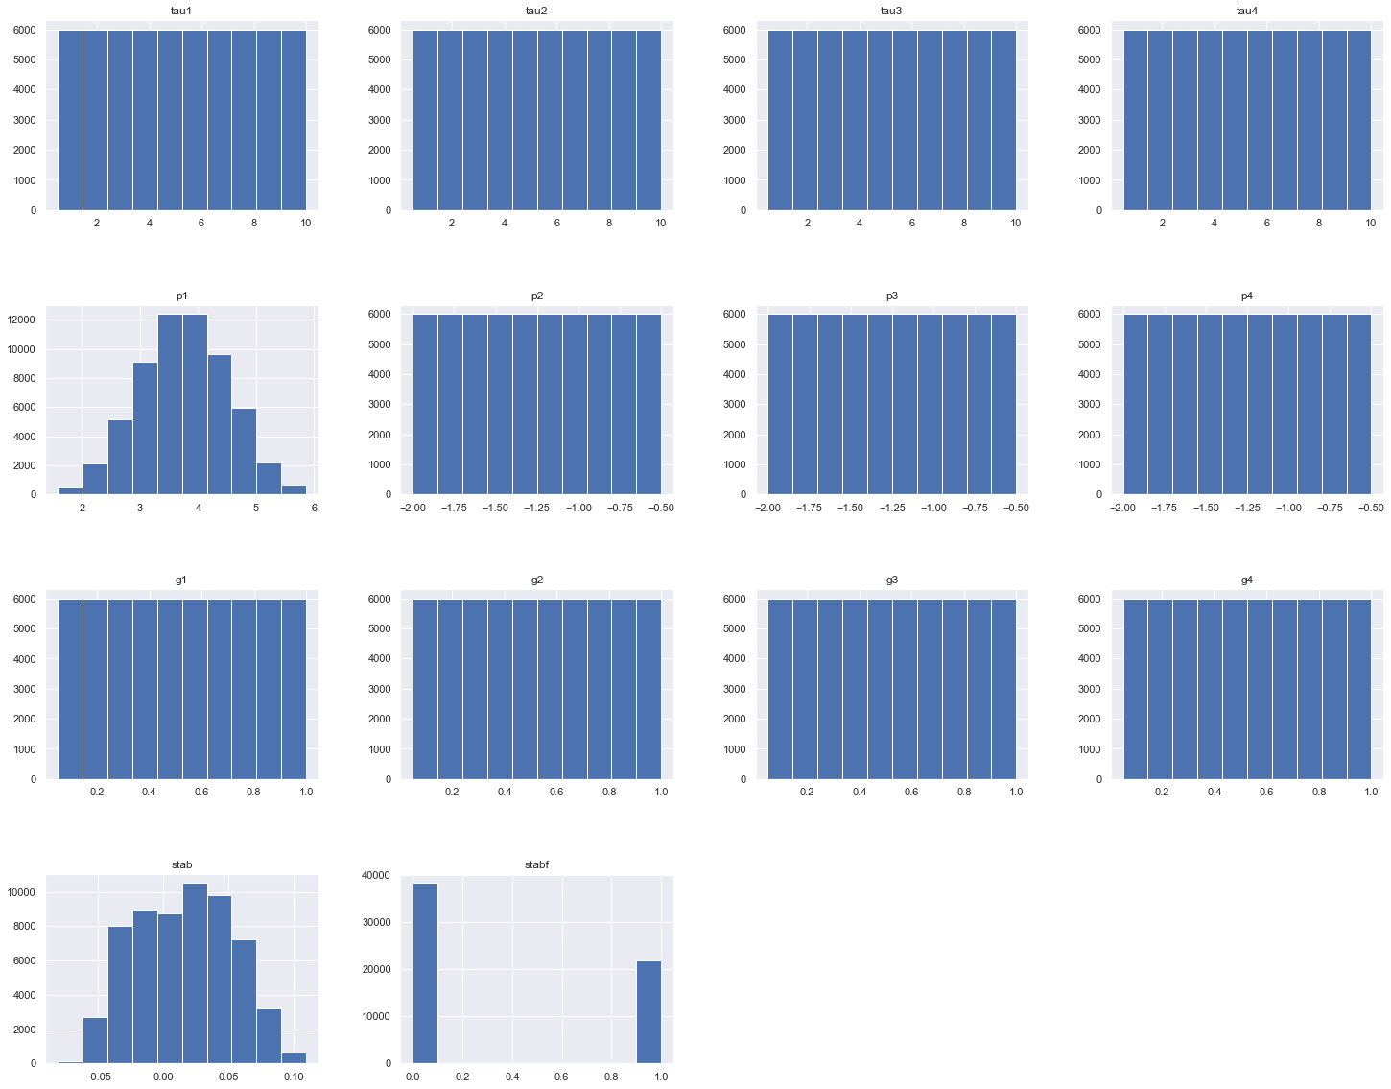
Variable Distribution
Tau – even distribution between (0.5, 10)
Normal power, p – p2, p3, p4 even dist. P1 = p2+p3+p4, normal dist.
Elasticity coefficient, g – even dist. Between (0, 1), g = c₁ * c₂
stab: If stab < 0, the grid is stable and stabf = "stable". If stab >= 0, the grid is unstable and stabf = "unstable"
Notes:
tau1, tau2, tau3 and tau4: the reaction time of each network participant. They are even distribution from 0.5 to 10 and each data bin (0-1, 1-2, etc.) has about 6000 samples for each variables.
p2, p3, and p4: nominal power consumed (negative) by each network participant. They are also even distribution from -2.0 to -0.5.
p1: nominal power produced (positive). p1=-(p2+p3+p4). It is approximately a normal distribution, which is able to be proved by the Central Limit Theorem. The mean is 3.75 and the standard deviationis 0.752.
g1, g2, g3 and g4: price elasticity coefficient for each network participant. They are even distribution from 0 to 1 to impact the electricity price as Figure 2(a) and (b).

Slide 7
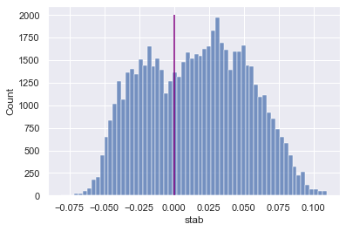
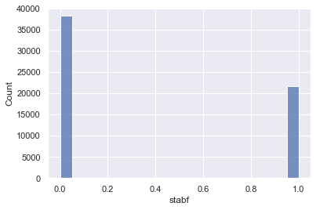
Exploratory Data Analysis (EDA)
Dependent variables
Augmented data (60,000 observations)
Dependent variables: stab, stabf
Stab>0 means stabf = unstable (=0)
Stab<0 means stabf = stable (=1)
Stable (stabf=1) ration = 35%

Slide 8
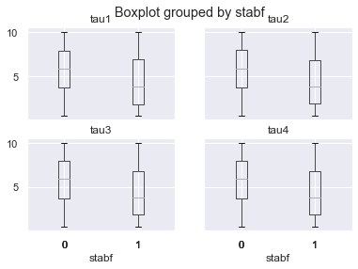
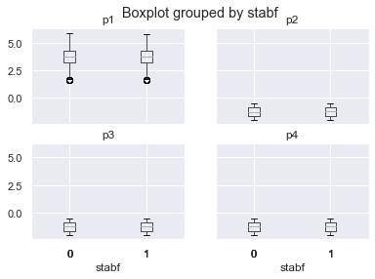
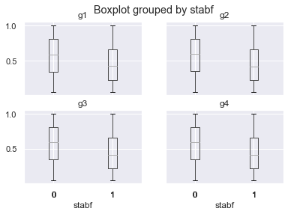
Exploratory Data Analysis (EDA)
Ranges of features
Box plots showing the ranges of features for unstable/stable cases.
The dist. Of tau and g are significantly different for unstable and stable cases.
The dist. Of p is not significantly different for unstable and stable cases.
Notes:
From the first boxplot grouped by stabf for tau1, tau2, tau3 and tau4, the mean and the range (25%,75%) of tau (reaction time) in unstable cases are significantly higher than those in the stable cases. There are the same trend for g1, g2, g3 and g4 about the price impacts. The normal power produced (p1) and the normal power consumed (p2, p3, p4) are not significantly different between the unstable and stable cases.

Slide 9
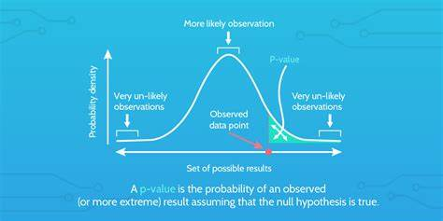
Exploratory Data Analysis (EDA)
Hypothesis tests
H_null: the observed difference in the mean of tau_i (i=1,2,3,4) between the unstable cases and the stable cases is due to chance. That is, tau_{i,u} = tau_{i,s}
H_null: g_{i,u} = g_{i,s}
H_null: p_{i,u} = p_{i,s}
P-value: the probability of obtaining results at least as extreme as the observed results assuming that the null hypothesis is correct.
Calculate p-value for each test: p-value = 0 for test 1 and 2. p-value = 0.008<5% significance level for test 3.
The null hypothesis are rejected, and the alternative ones are accepted.
Notes:
In statistics, the p-value is the probability of obtaining results at least as extreme as the observed results of a statistical hypothesis test, assuming that the null hypothesis is correct.

Slide 10
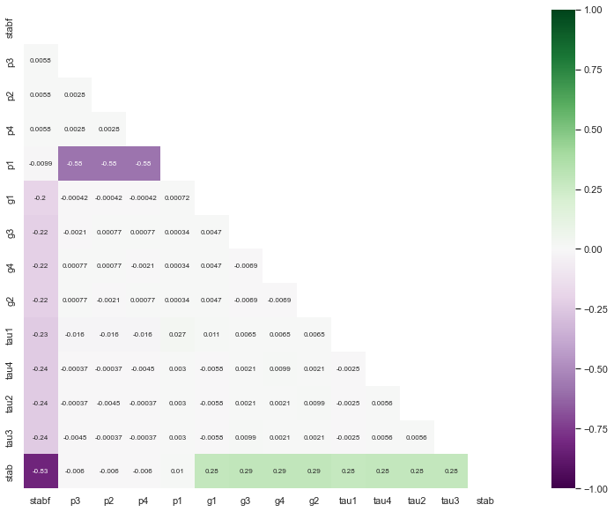
Pre-processing
Correlation
Heat map to show the correlations of features with stabf
Stab is 0.83 as the definition
Tau_{i} (i=1,2,3,4) are -0.24
g_{i} (i=1,2,3,4) are -0.22
p_{i} (i=1,2,3,4) are -0.006.
This verified the hypothesis tests
Notes:
It is important to verify the correlation between each numerical feature and the dependent variable, aswell as correlation among numerical features leading to potential undesired colinearity. The heatmap below provides an overview of correlation between the dependent variable ('stabf') and the 12numerical features.

Slide 11


Pre-processing
Segregating train and test sets
Feature assessing and scaling
Ratio of train and test = 9:1
Augmented data
Train data: 54,000
Test data：6,000
Original data
Train data: 9,000
Test data：1,000
scaling is fitted and transformed to the training sets and transformed testing sets
Augmented data
Original data

Slide 12
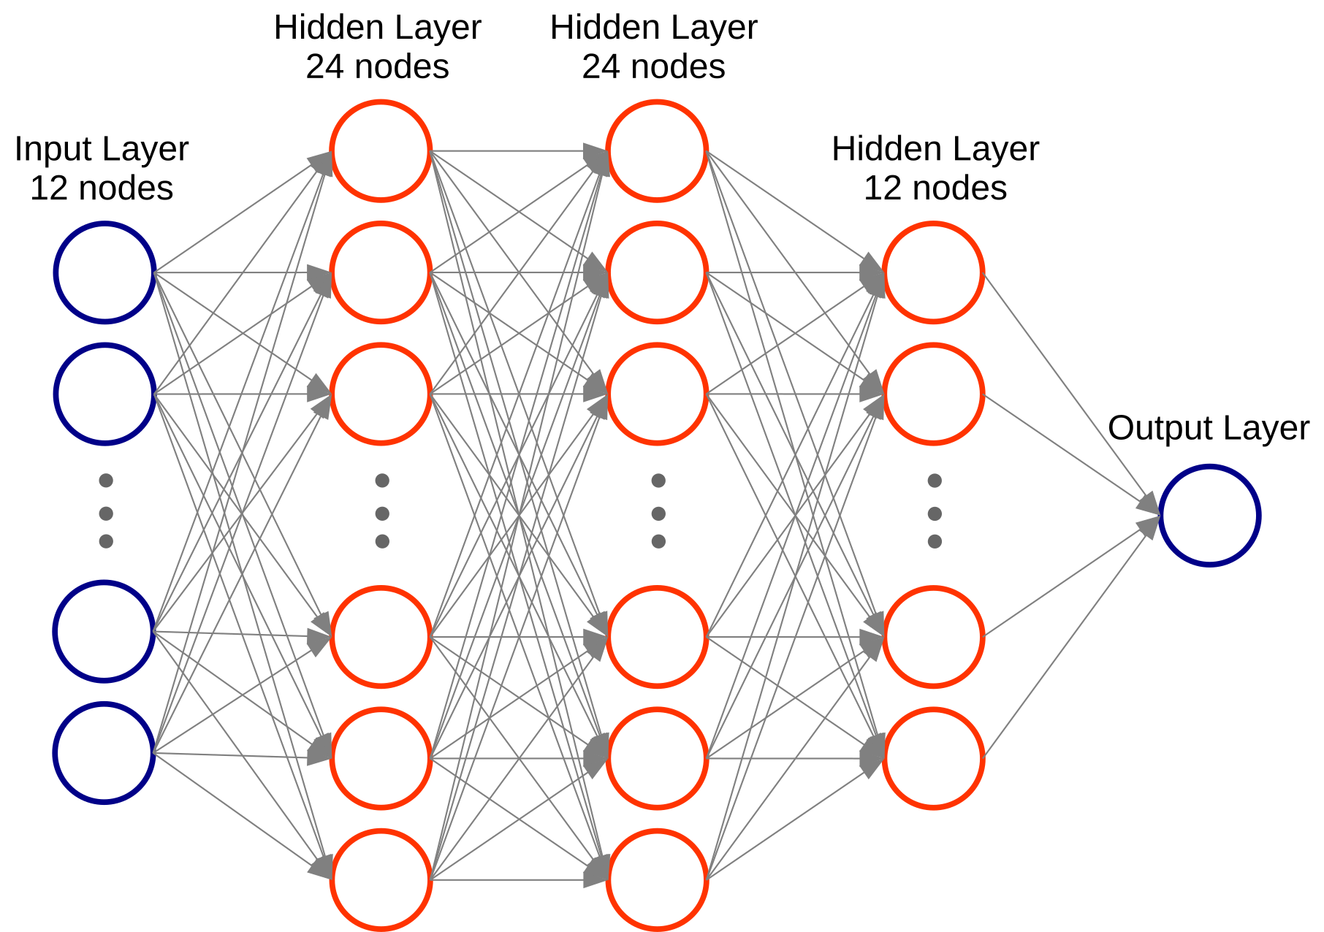
Deep Learning - ANN
One input layer (12 input nodes);
Three hidden layers (24, 24 and 12 nodes, respectively);
One single-node output layer.
Choice of 'relu' as the activation function for hidden layers
Choice of 'sigmoid' as activation for the output layers
Choice of 'adam' as optimizer and 'binary_crossentropy' as the loss function

Slide 13
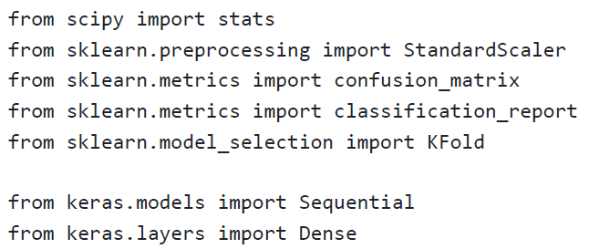
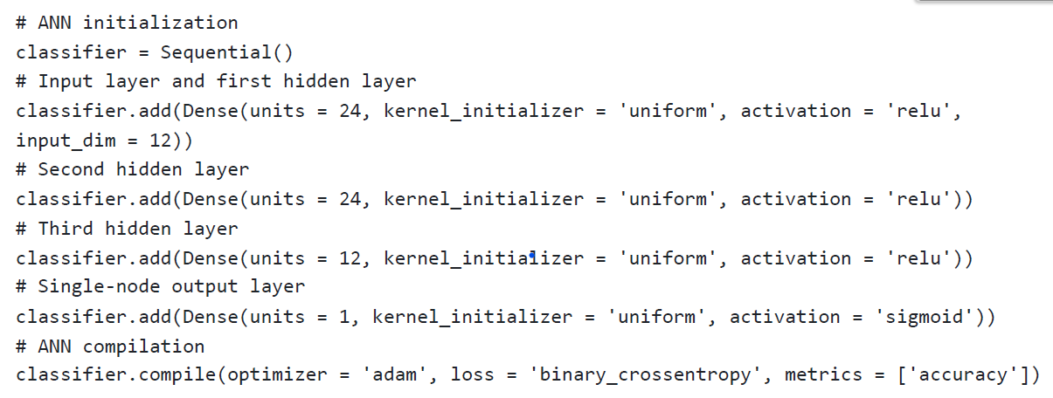
ANN Python Codes
Sequential from keras lib was introduced;
Input and 1st hidden layer added
2nd hidden layer added
3rd hidden layer added
Single node output layer added
Compilation with ‘adam’ and ‘binary_crossentropy’

Slide 14
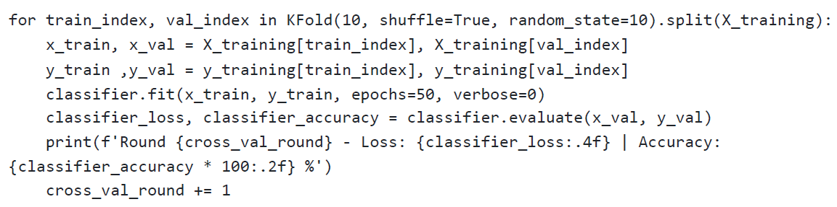
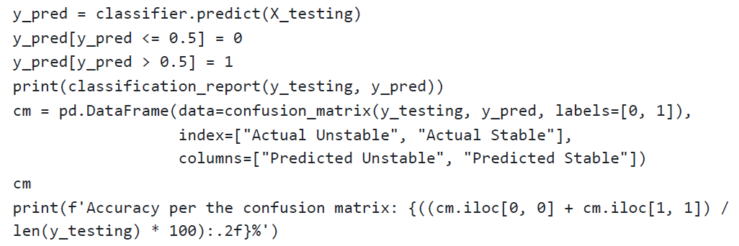
ANN Model Fitting
a cross-validation based fitting is proposed.
Kfold=10 is the cross-validation engine selected and epoch=50
The percentage of unstable cases is 65%, so Classification Report (f1-score) was compared with the accuracy.

Slide 15
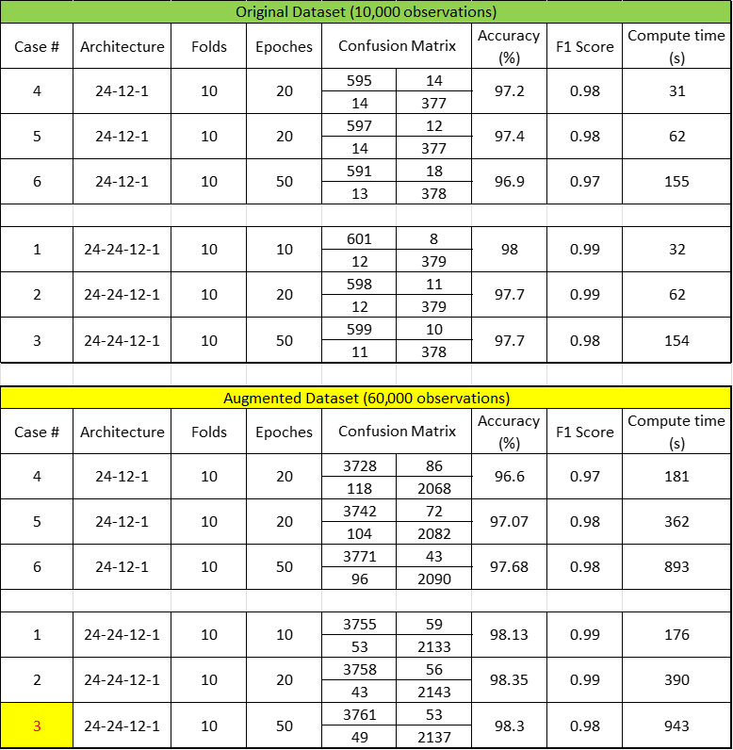
Tuning Parameters of ANN
In addition to the base case, 11 cases for different ANN architecture
3 hidden layers vs. 2 hidden layers
epoches = 10, 20, 50
datasets = augmented sets vs original sets
F1-score is true performance on both balanced and imbalanced datasets.
F1-score considers both the precision and recall ability of the model.
Notes:
From Table 1 below, we know all cases have the F1 Score within the range of (0.97, 0.99) and the accuracy between 96.6% - 98.3% for this classification problem. The architecture network are three ortwo hidden layers, which have slight impacts on the F1 score (accuracy) and computing time. It seems that three layers will help the F1 score slightly. The augmented dataset (obtained by permutating theoriginal data) also increases the F1 score and the accuracy slightly. But, the augmented data consume about 6 times of computing time than the original dataset, which is proportional to the size ofdatasets.

Slide 16
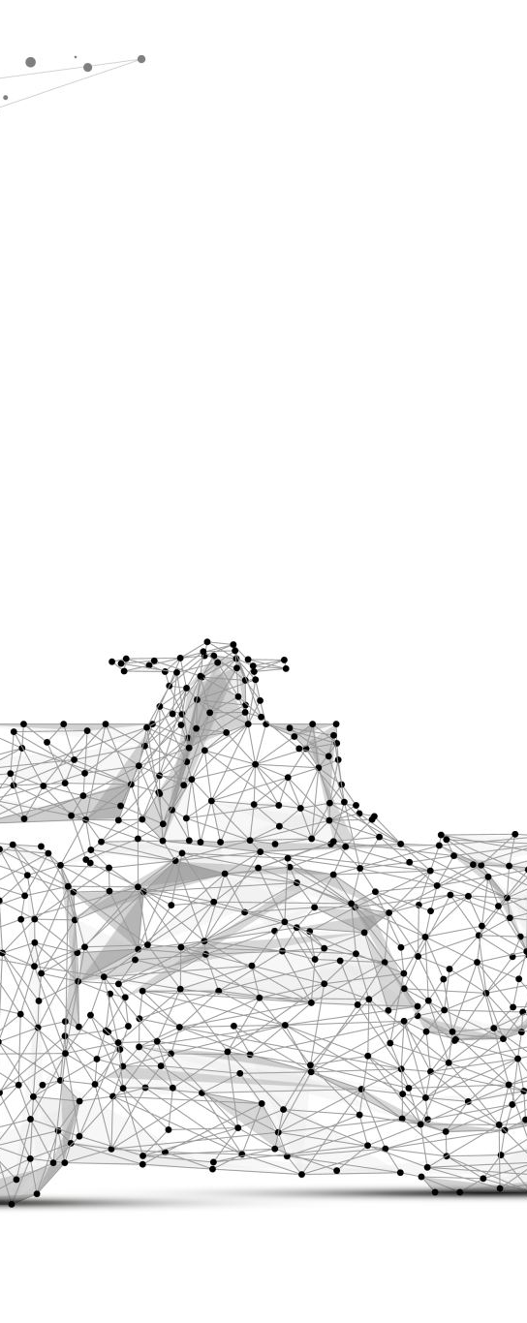
Conclusions
All cases had the F1 Score within the range of (0.97, 0.99) and the accuracy between 96.6% - 98.3%for this classification problem.
The hidden layers of the architecture network had slight impacts on the F1 score (accuracy) and computing time. It seems that three layers helped the F1 score slightly.
The augmented dataset also increases the F1 score and the accuracy slightly. But the augmented data consume was proportional to the size of dataset.
For this basic power grid, the model with two hidden layers, 10 folds and 10 epoches on the augmented dataset is preferrable to predict the power grid stability.

Slide 17
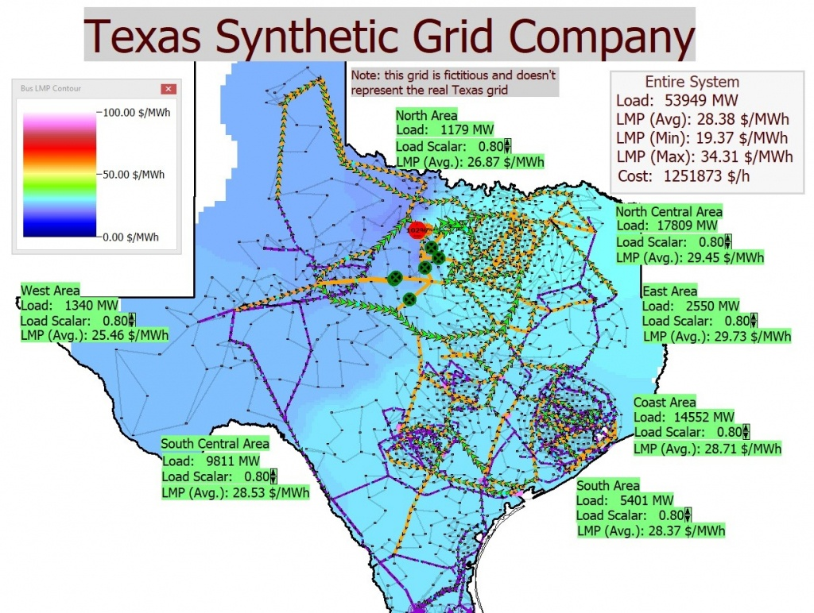
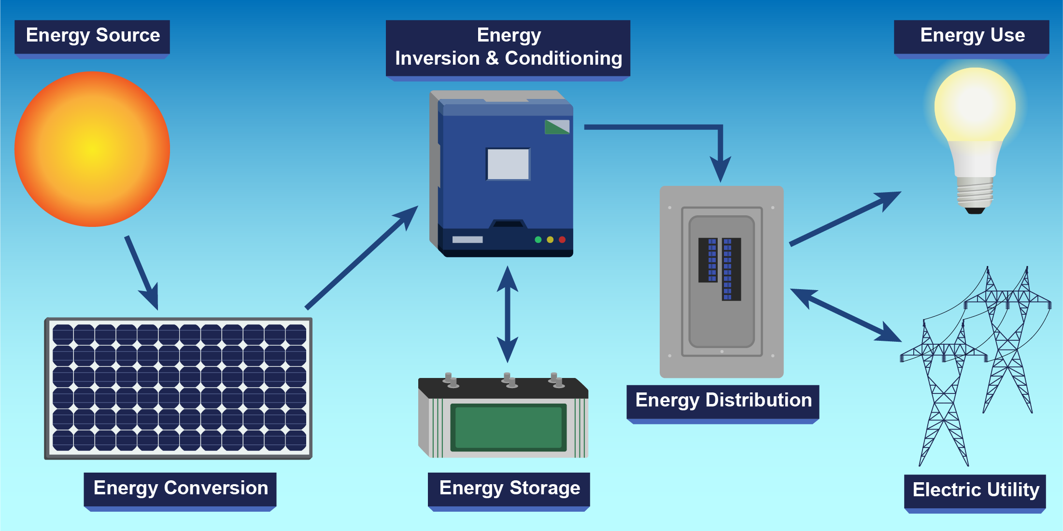
Future Work
For this basic 4-node-star power grid, the ANN model has very good F1 score (accuracy) to predict the stability. To apply for this ANN model into the real operation of power grids, we still have more challenging tasks to solve.
More nodes of power plants and end users
Solar energy implementation in the commercial and residential users
More battery-based electricity storage implementation

